Slide 1
Llechi Glo a Chefn Gwlad
Ethan Jones & James Hall 22rd May 2020

Slide 2
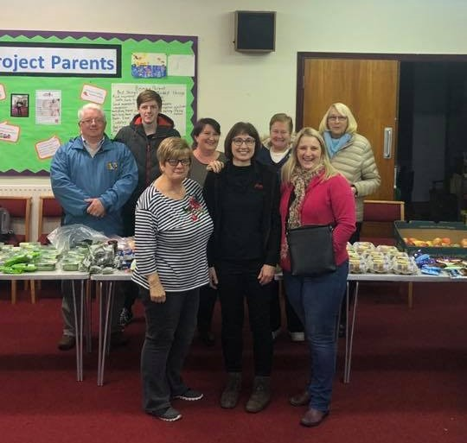
How I got here
ICT & Design and Technology 6th form
College studied Game & Web Design
1 year ago graduated from university course in ICT
Want to pursue a career in Games & Coding
Take part in a community food bank with salvation army.

Slide 3
Why P&W are joining the project
45,000 jobs in the digital/tech industry in South Wales
Linking businesses, universities and schools
FREE online resources
Sustained digital clubs
Help improve/build upon digital skills

Slide 4
What we’ve accomplished so far
Code clubs
Aberdare Church Primary
Canolfan Pentre
WTOW Old Library
Events
Digital festival
Girls in Tech weekend
Other Opportunities
Creative writers group

Slide 5
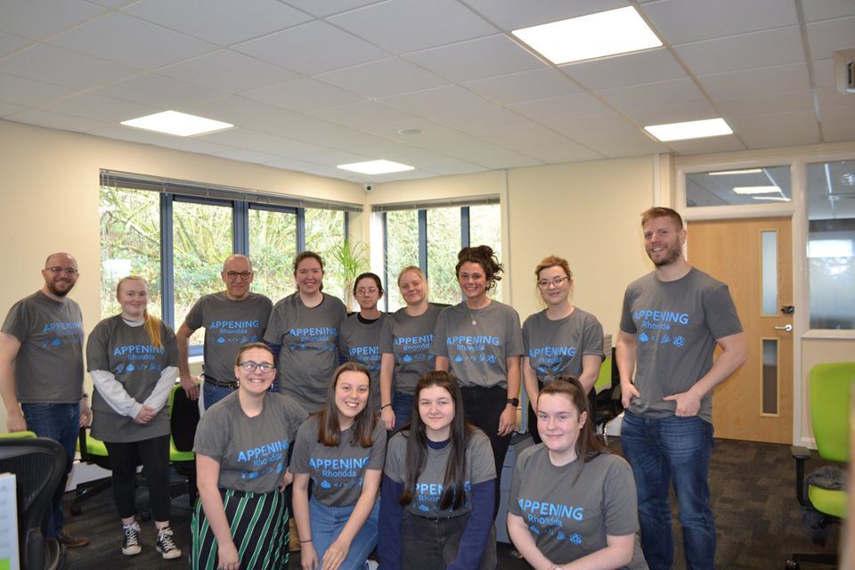
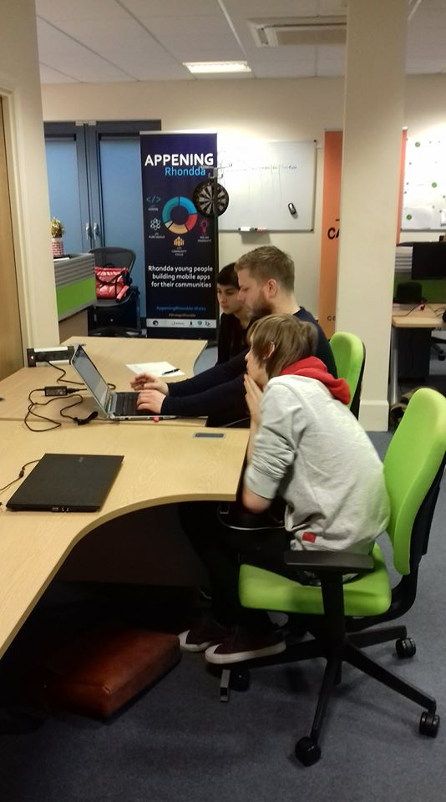
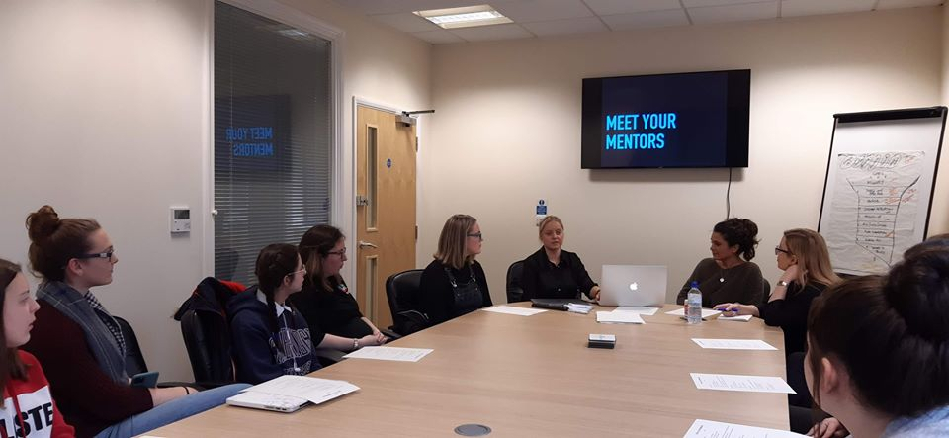
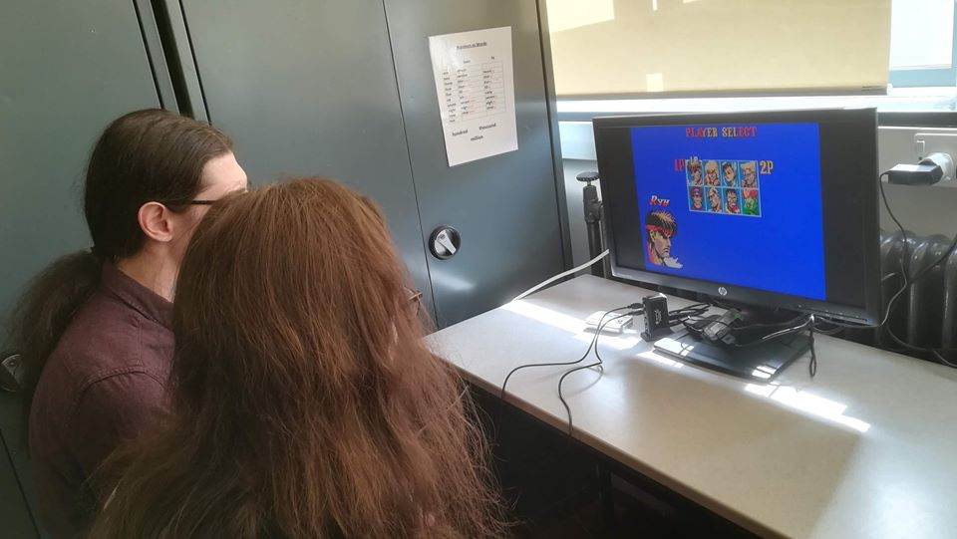

Slide 6
Future Plans
Future Plans
Coleg y Cymoedd Aberdare campus
Ferndale Library
Surrounding schools
Future plans
Digital festival 2.0
More Tech weekends

Slide 7
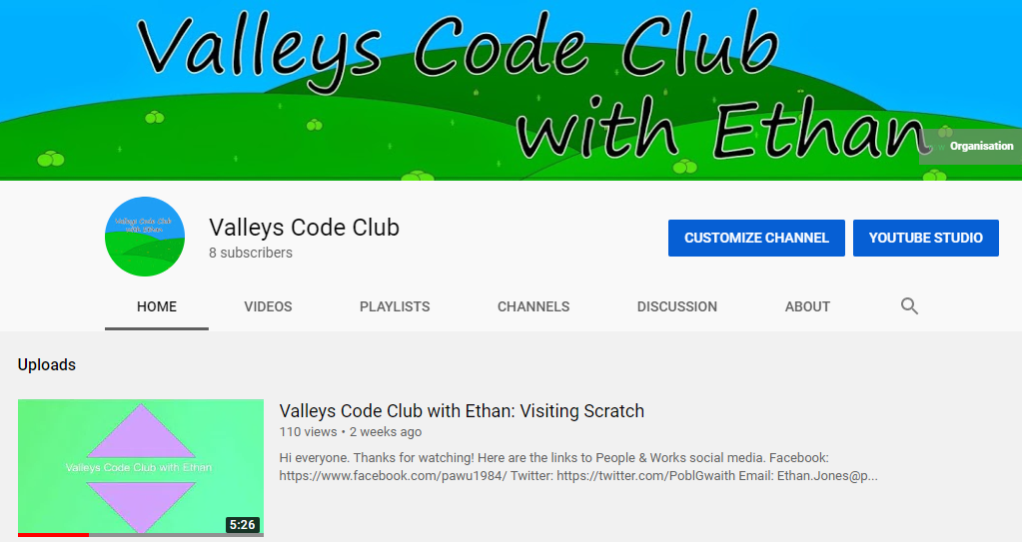
Covid-19 Impact
Sharing coding resources
Developing my own skills
Creating websites
www.playitagainsport.wales
www.gadnichwarae.cymru
https://www.youtube.com/channel/UC8_1xSsVRH4CJ9ndun8Cw7Q

Slide 8
‘Finding answers – making change possible’

Slide 9
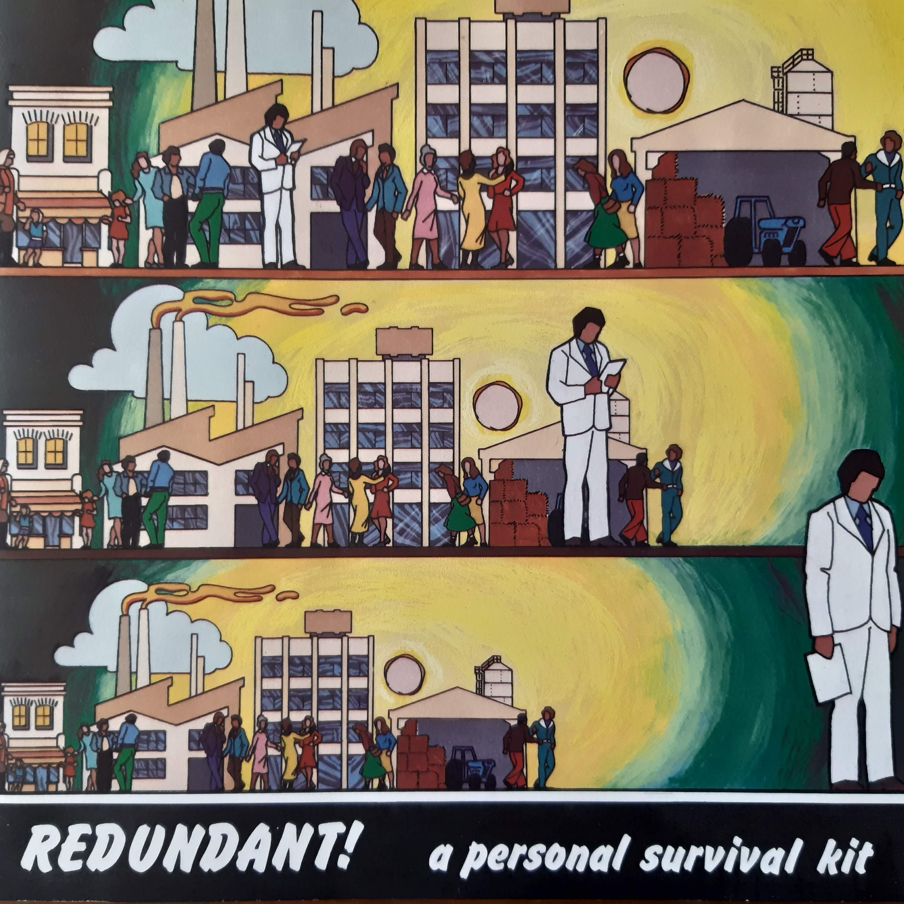
Dur/Steel

Slide 10
Maggie, Maggie, Maggie!
Industrial unrest, redundancies
Steel ‘Slimline’ 1980s

Slide 11
People & Work – established 1984
Social research – what happens to people & communities?
Sharing learning with others in industry, community, government
Piloting different ways of work
Founded by a group of workers in the community and industrial mission
The centrality of human dignity in the economy

Slide 12
Education, education, education!
Three teams within a team
Research, Projects/Partnerships, Social Enterprise
Research/evaluation has included poverty/education, SEN/ALN, refugees/employment, autism…. mainly Wales but also wider
Projects have included youth work/leadership, construction, care, education, sport, coding, wellbeing, advice & guidance
Social enterprise: Play It Again Sport – ‘taking the cost out of taking part’

Slide 14
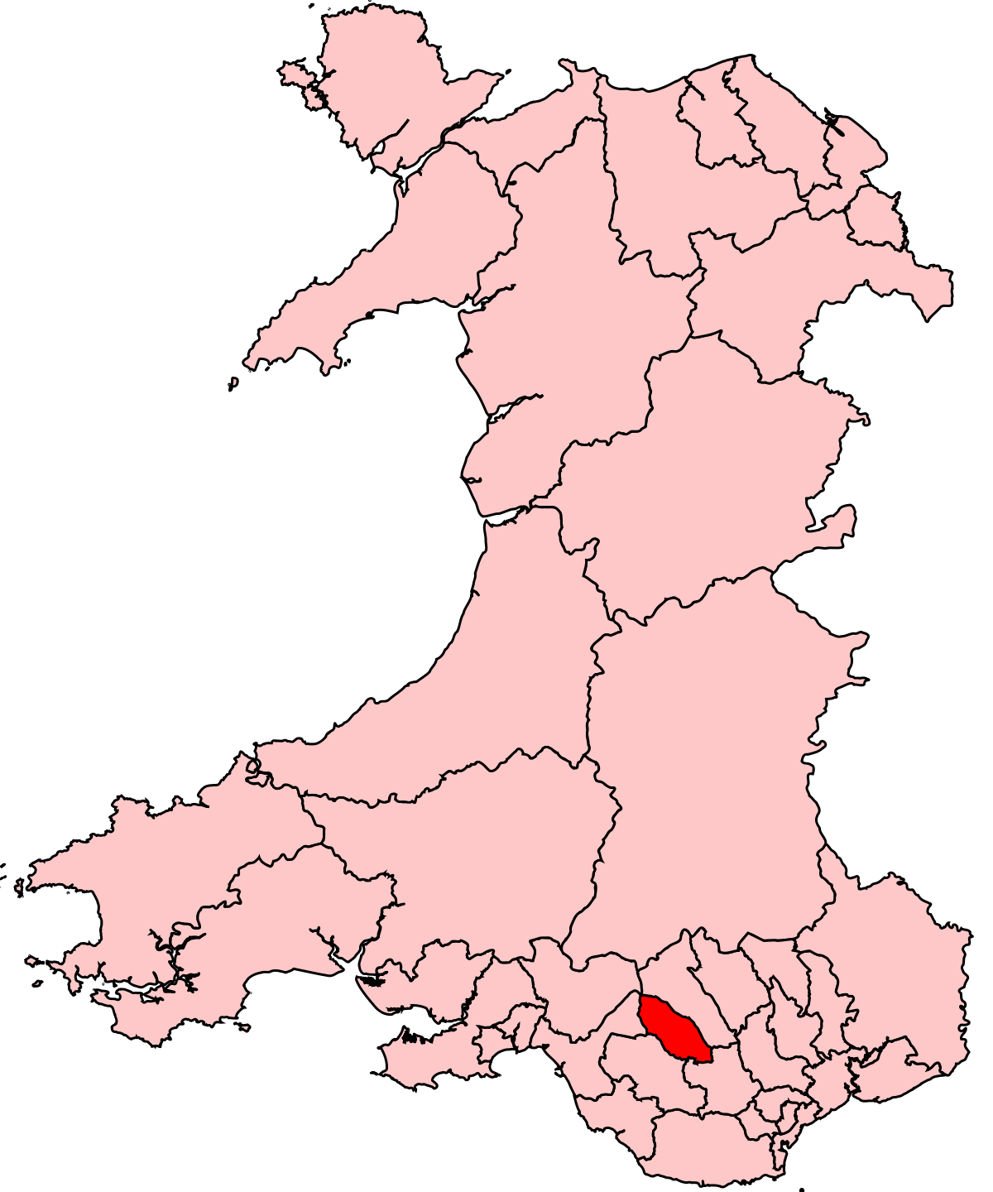

Slide 15
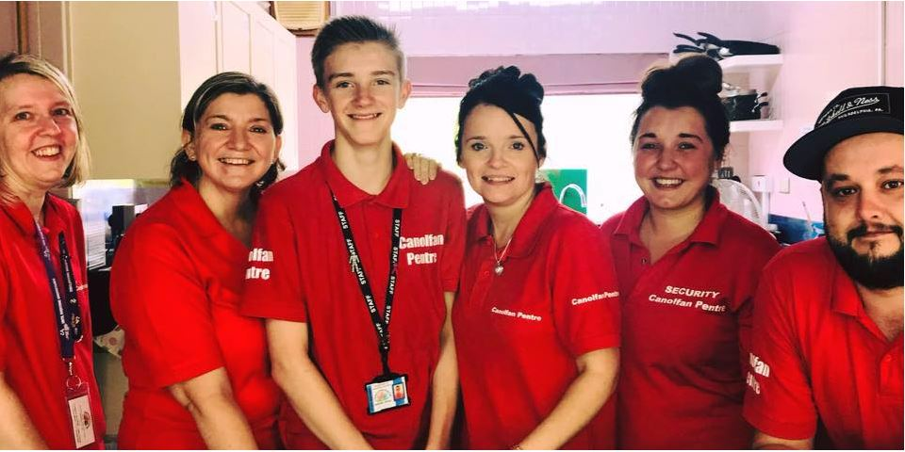
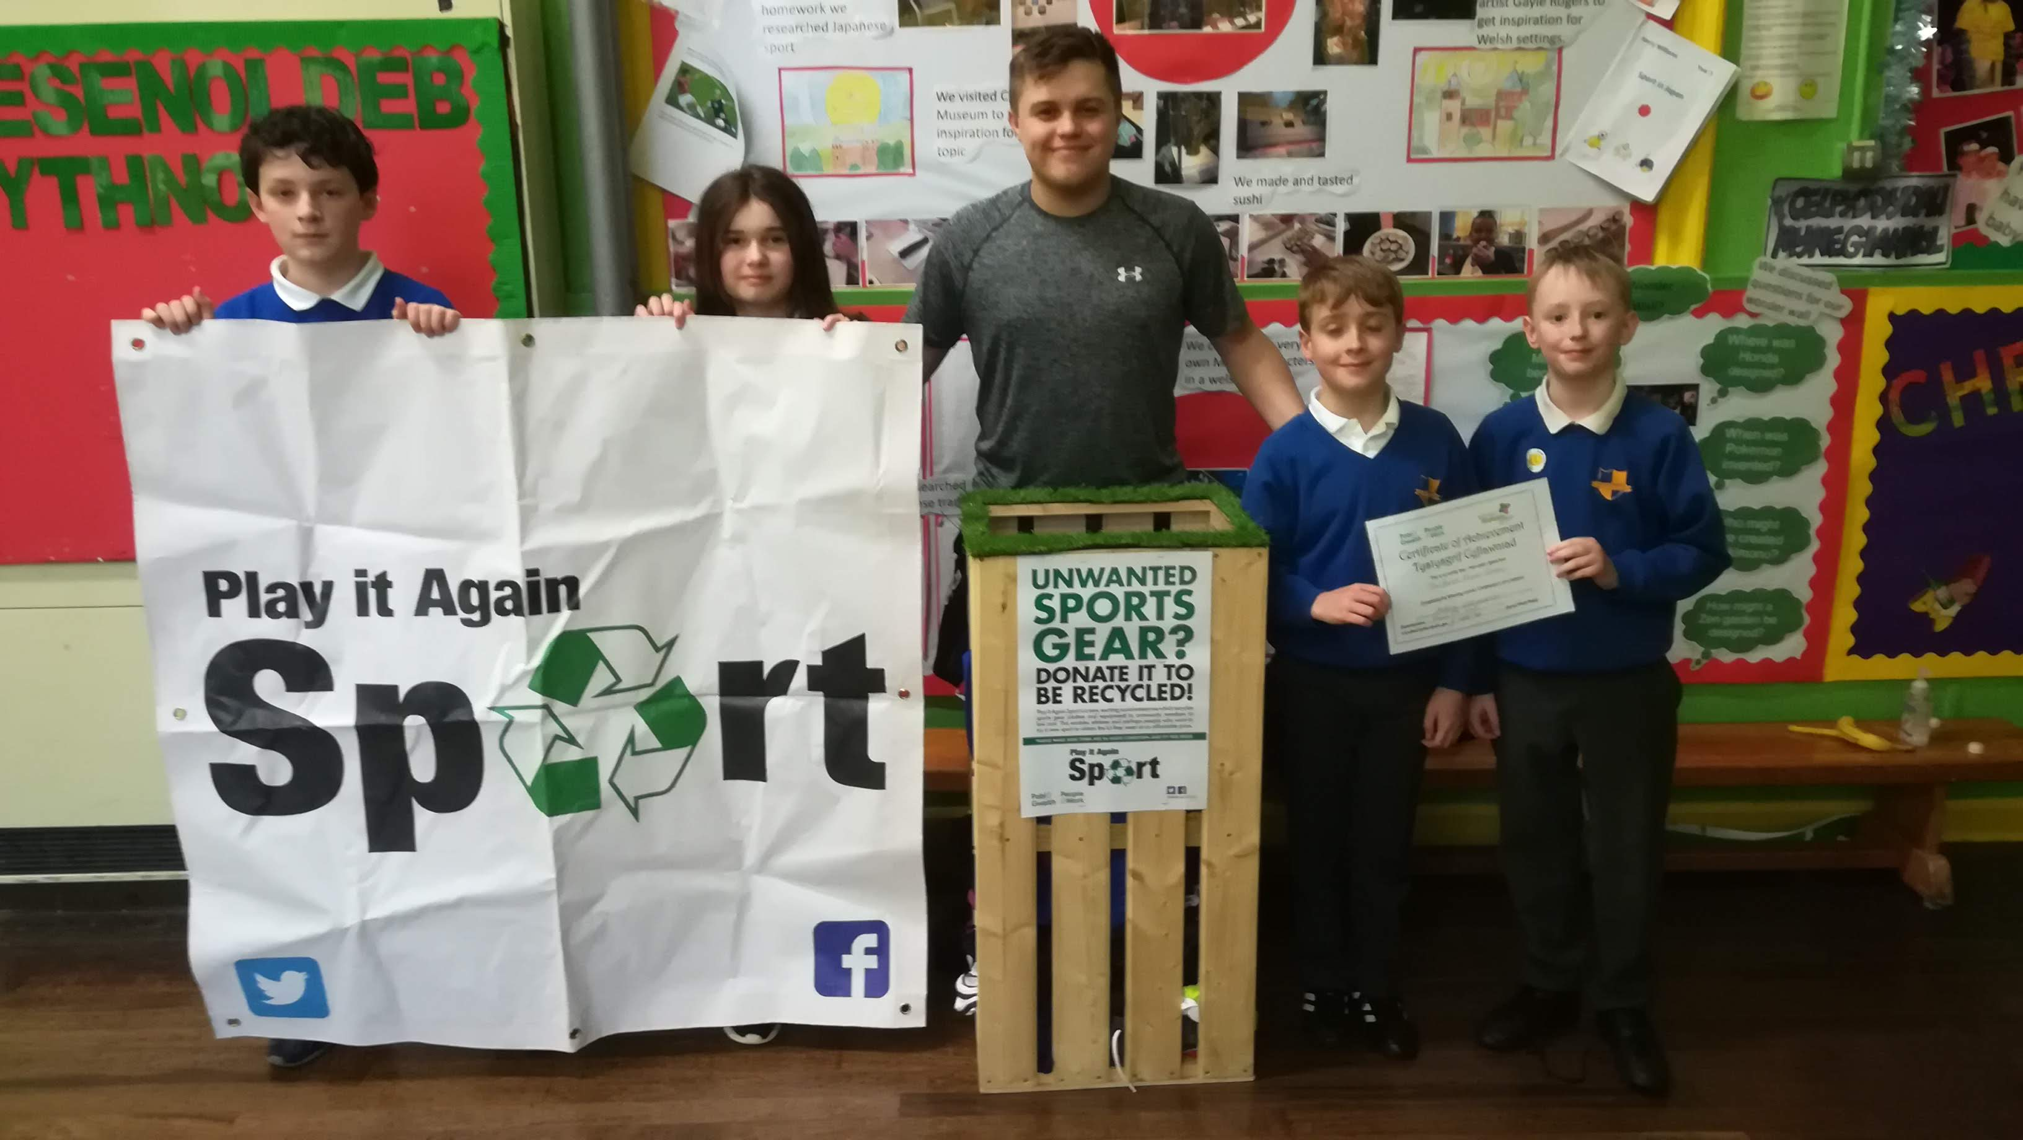
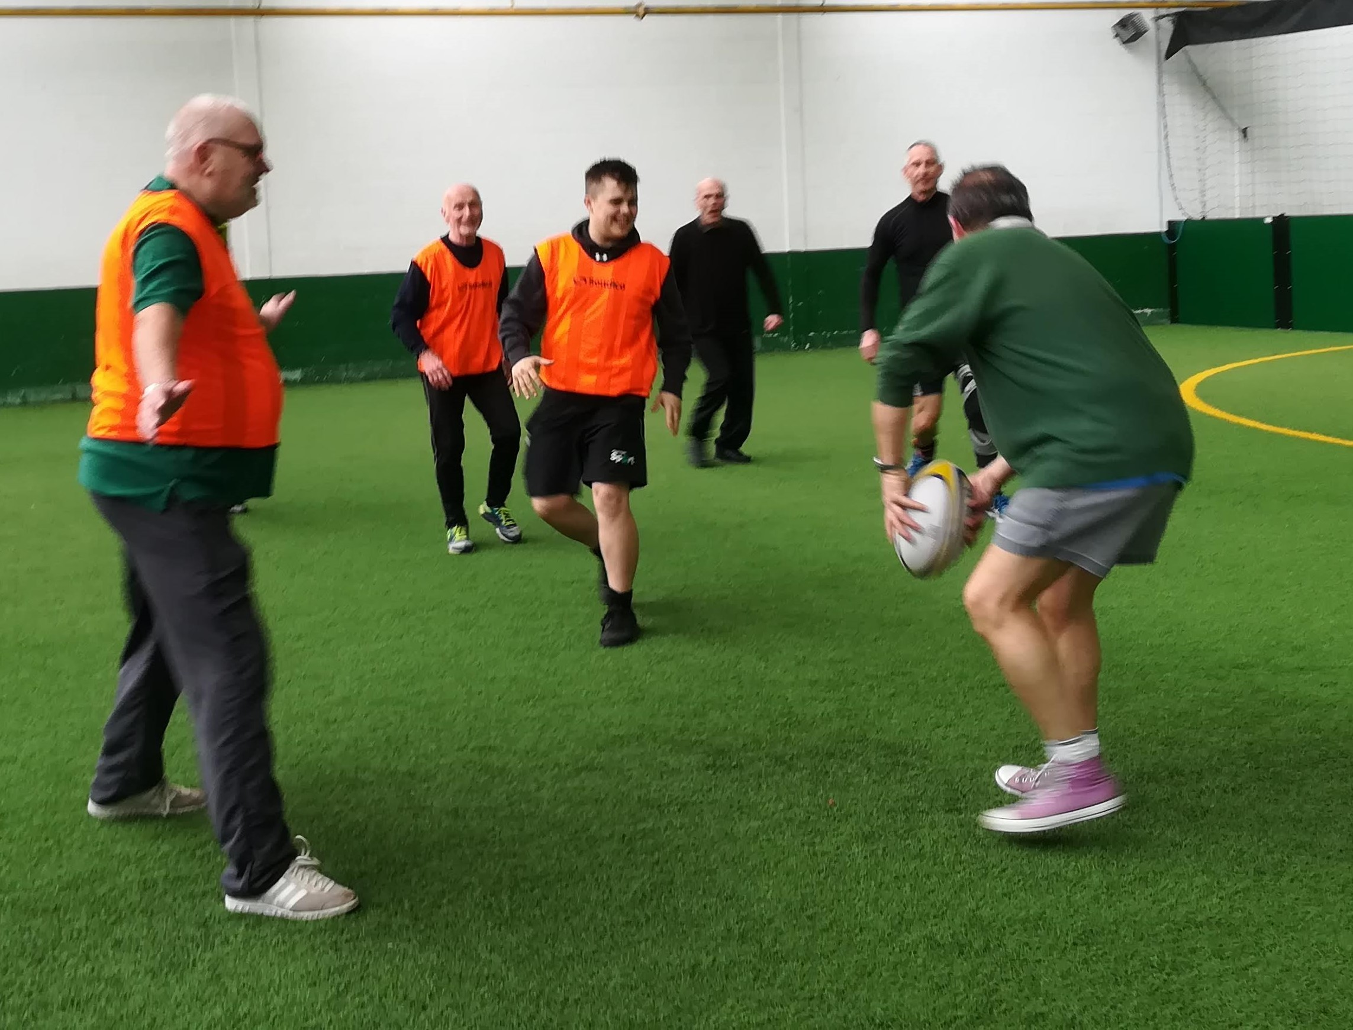
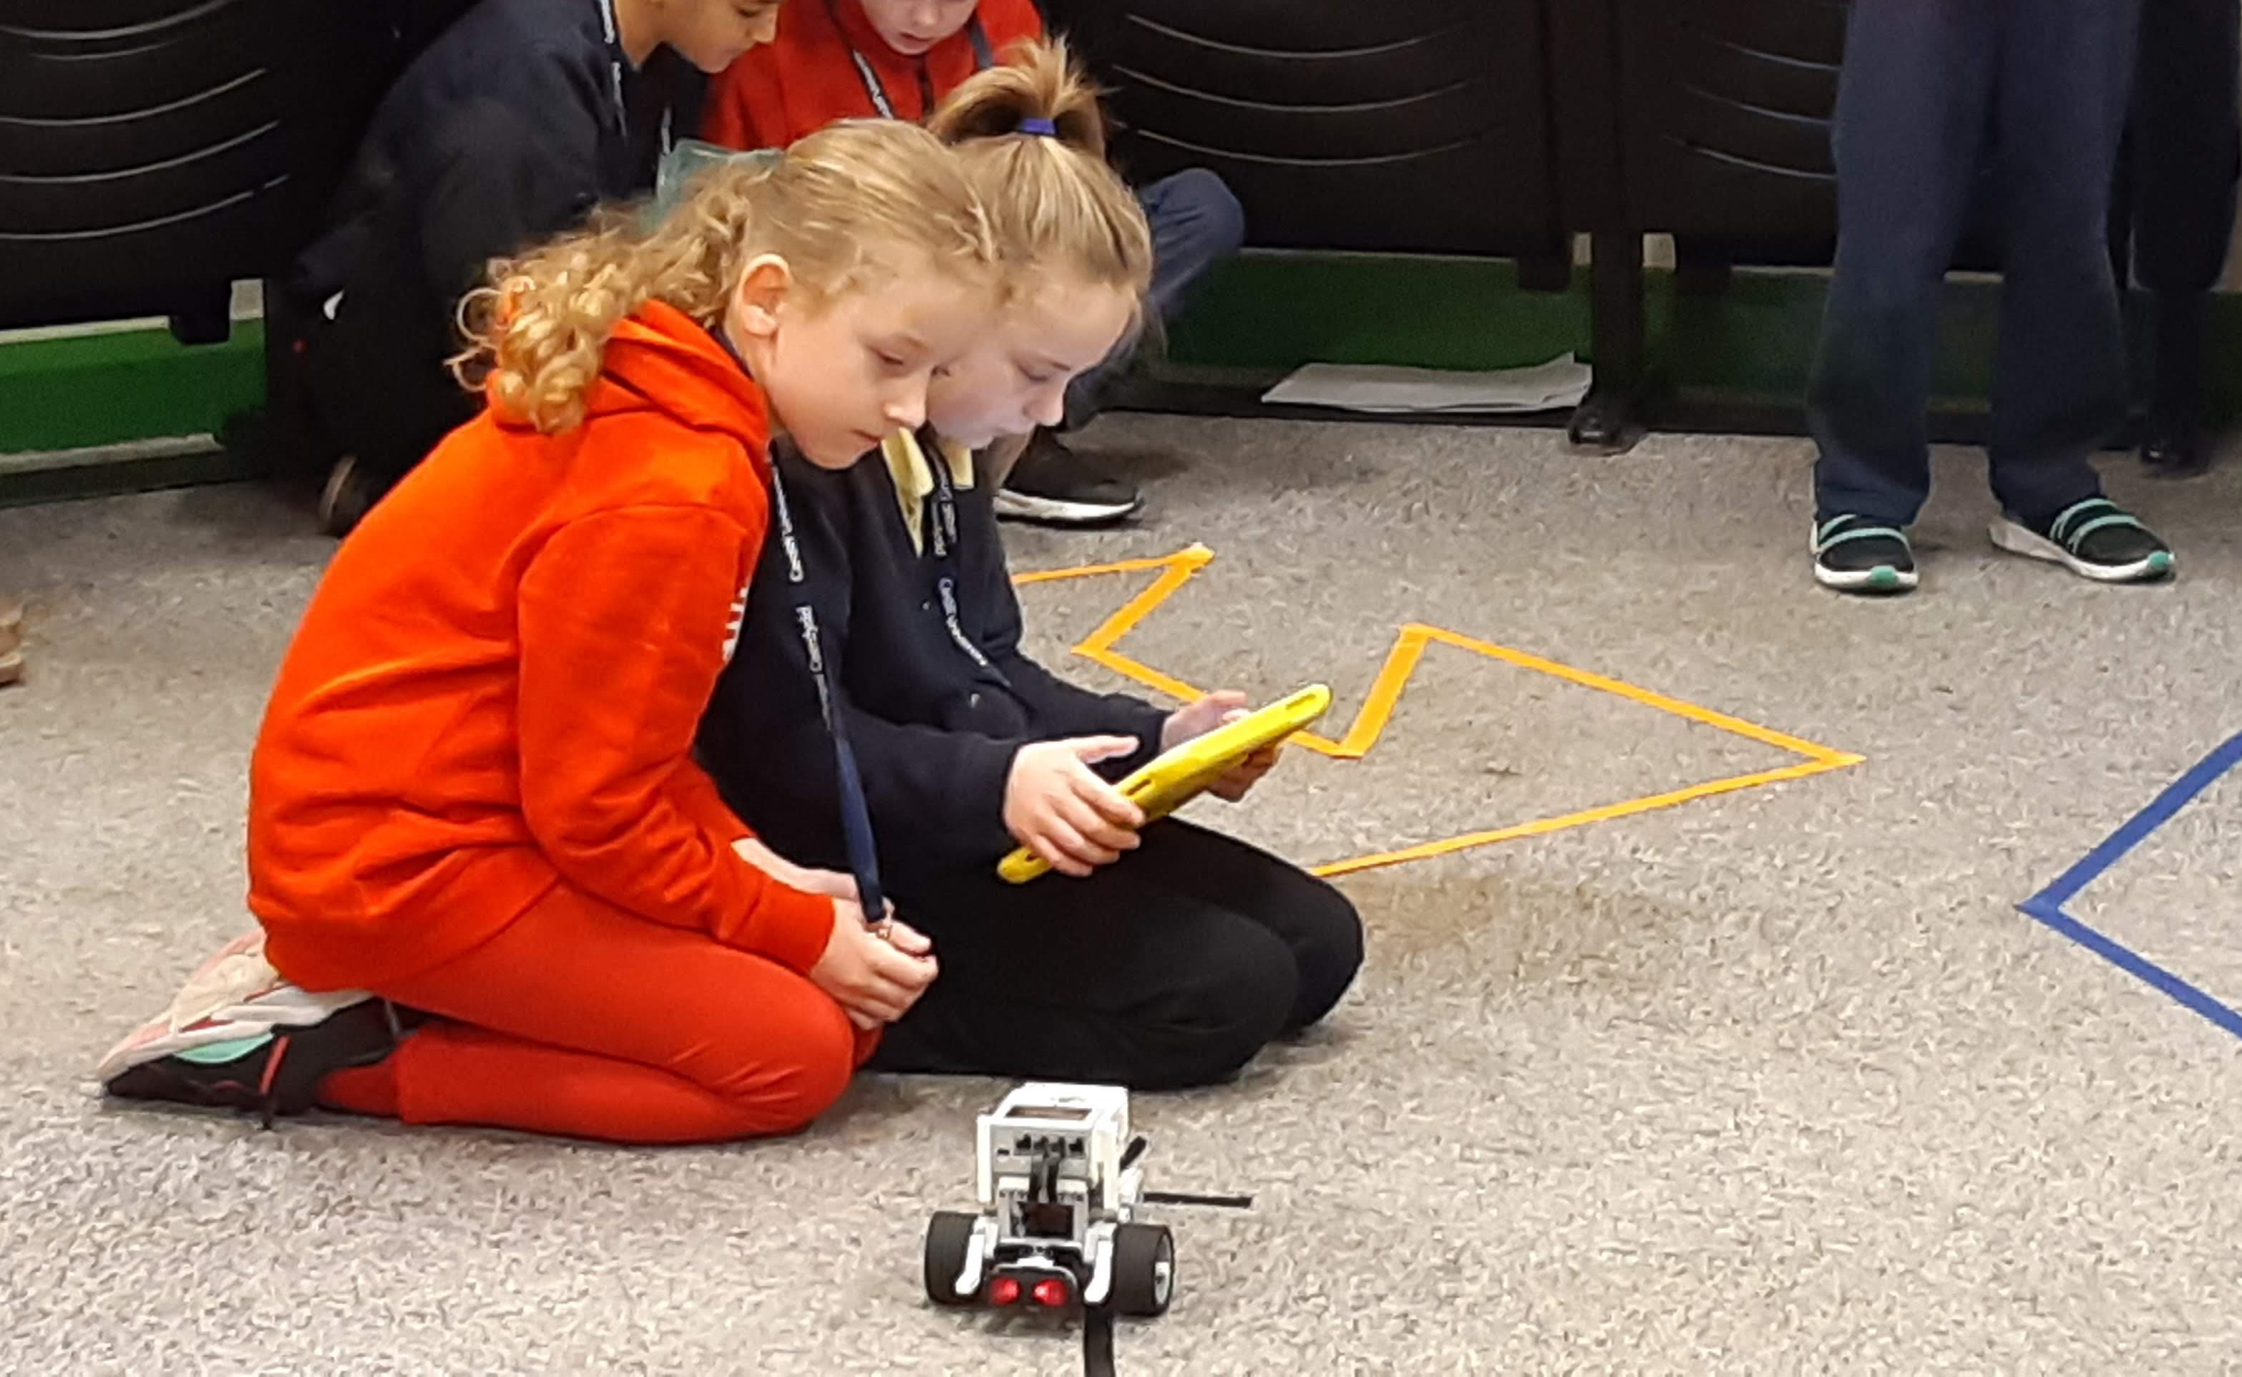
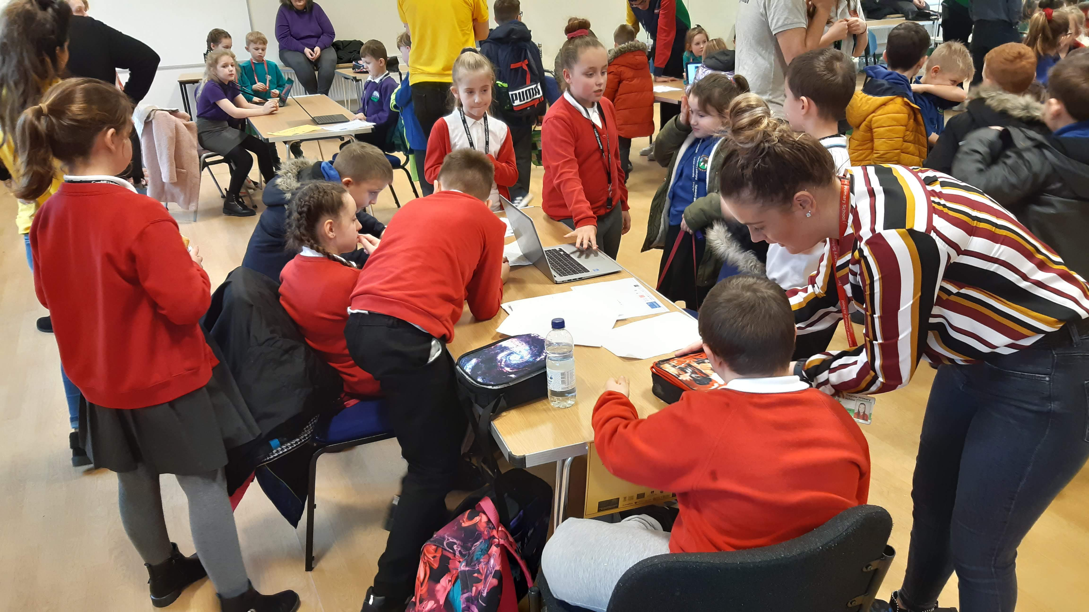
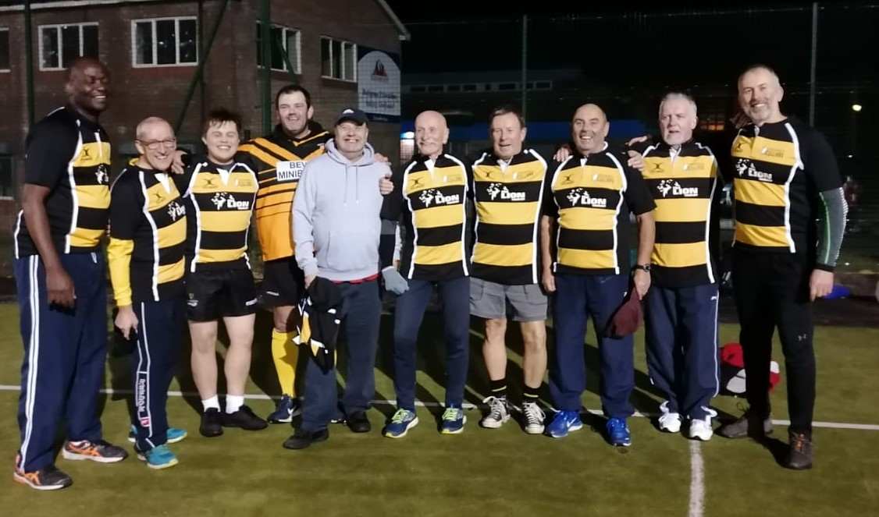
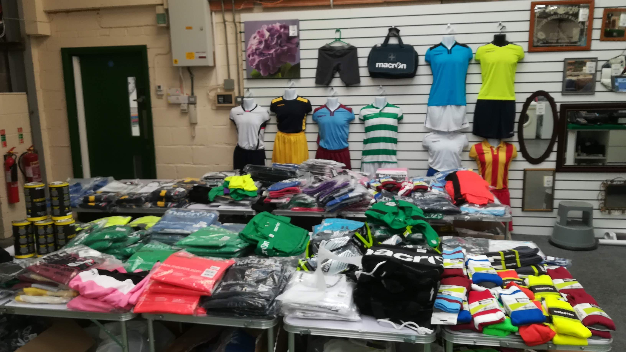
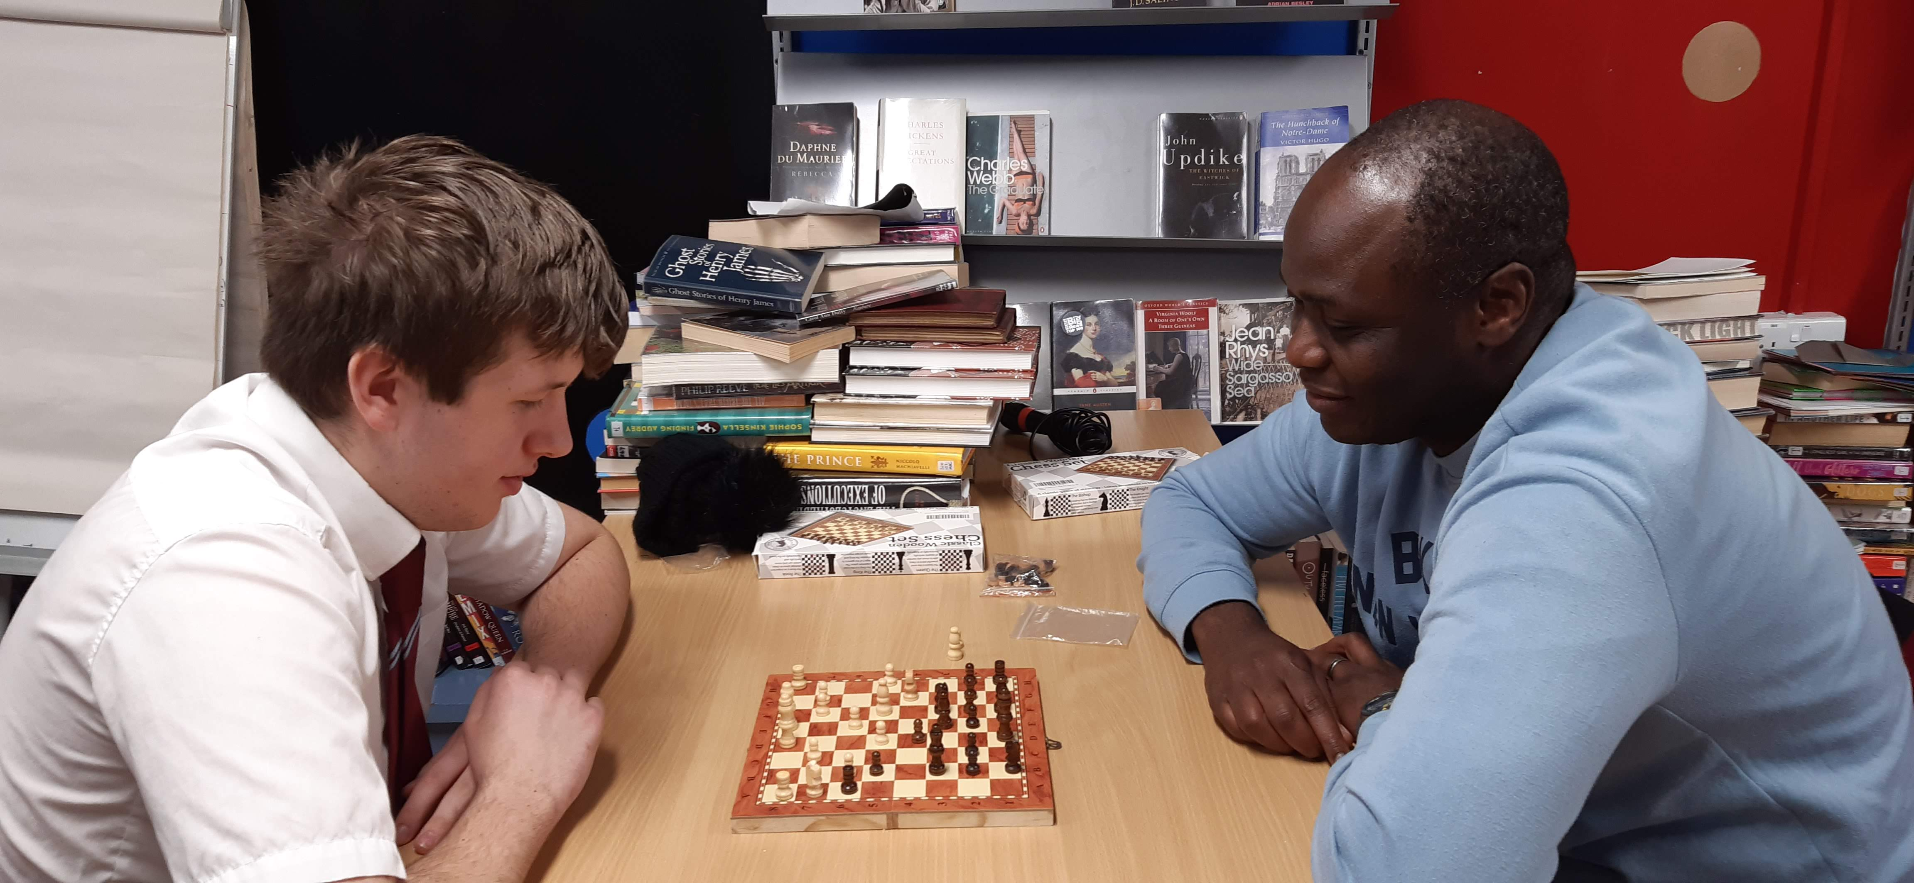
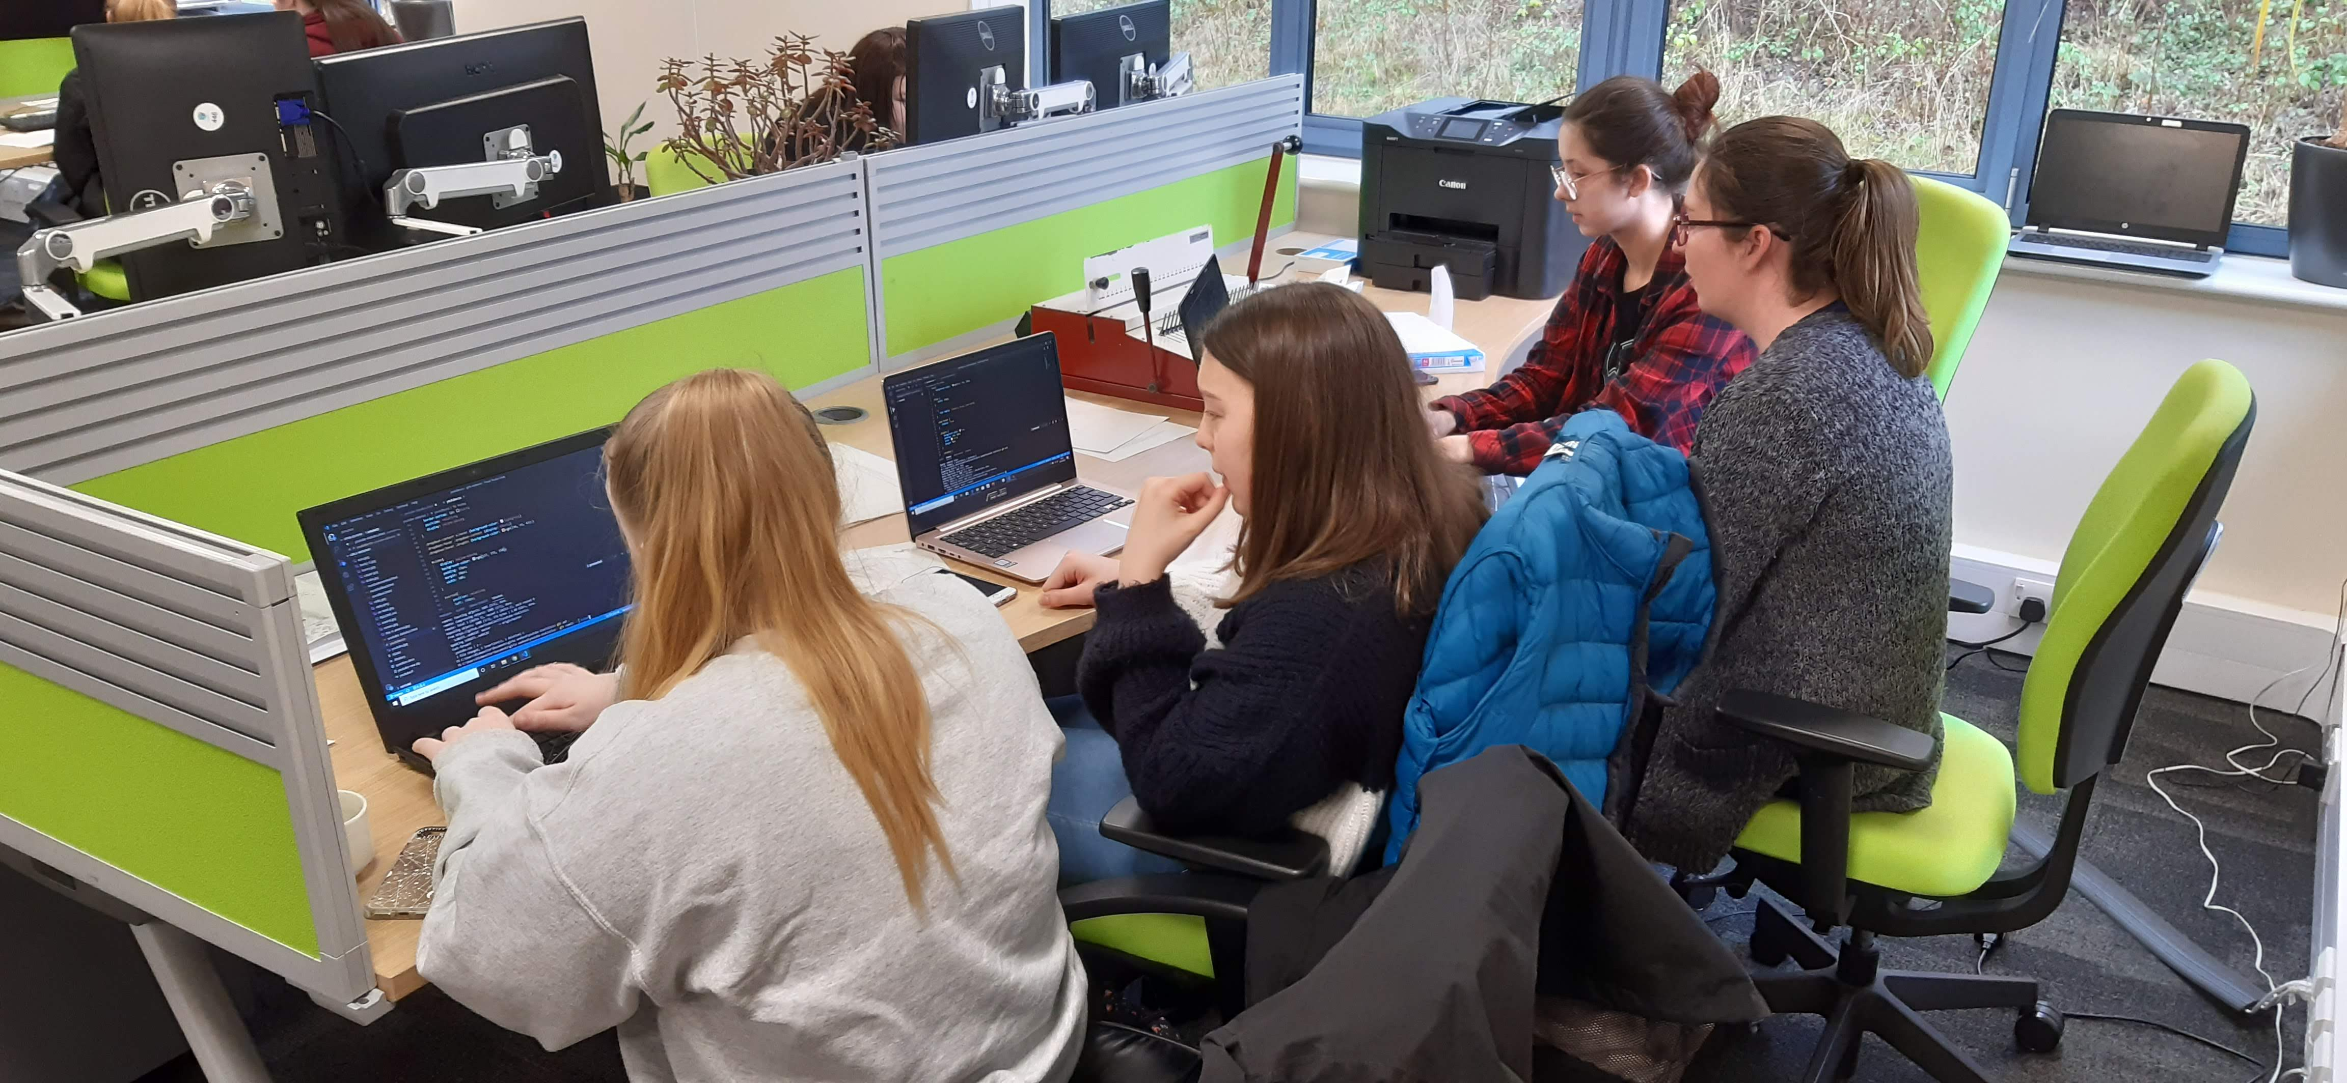

Slide 16
Diolch/Thank you
James.Hall@peopleandwork.org.uk
Ethan.Jones@peopleandwork.org.uk
peopleandwork.org.uk
@PoblGwaith @PIAS_Wales

